Slide 1
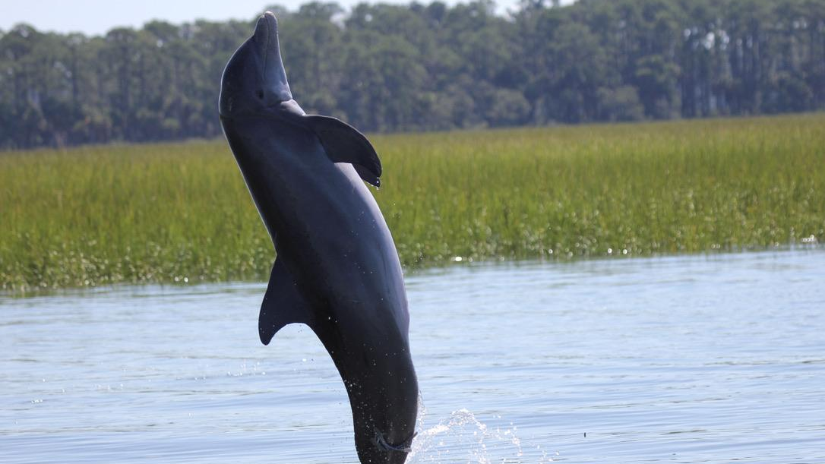


Assessing the relationship between bottlenose dolphin vocalization and abundance patterns in Charleston Harbor, SC
Caroline Tribble | CofC
Dr. Eric Montie | USCB
NMFS Permit #24033
Photographer: C. Tribble

Slide 2
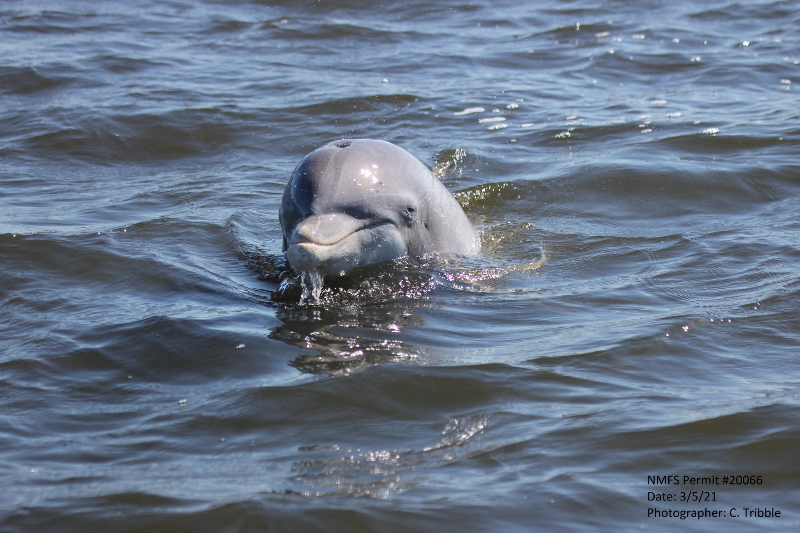
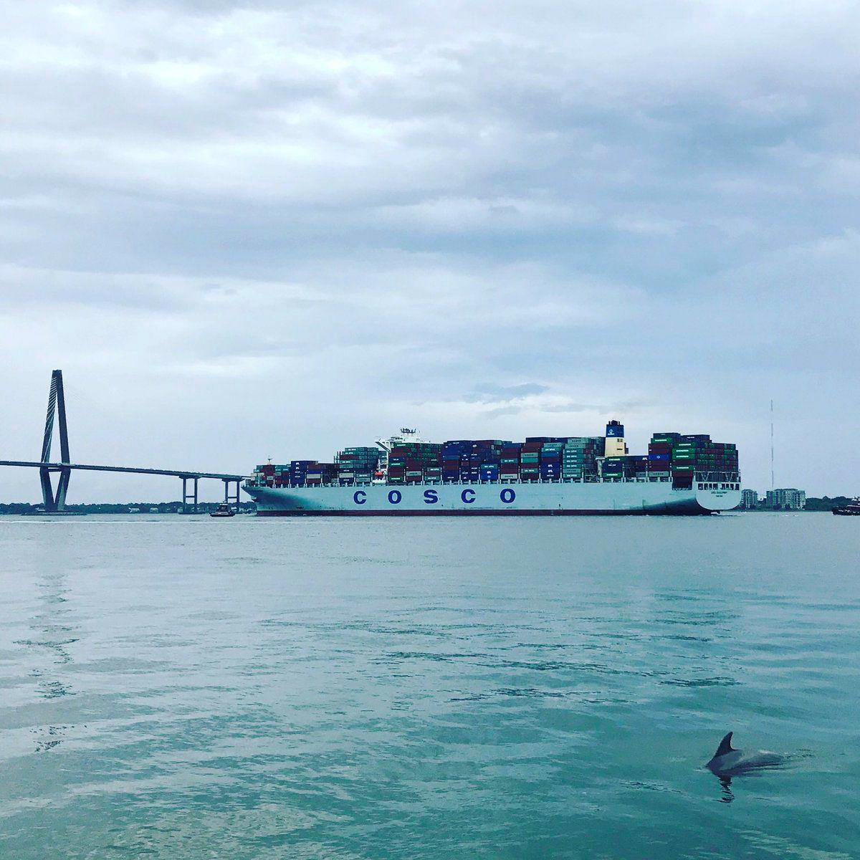
Significance of study
Keystone species
Underwater noise pollution
Dredging impacts
Can passive acoustics serve as a predictor of abundance?
Can these data be used to tease out detection range?
How complex is this relationship?
Notes:
Atlantic common bottlenose dolphins are widely distributed off the South Carolina coast and are representative keystone species within our harbor. They rely on a range of vocalizations to communicate, forage, and navigate in their environment. Charleston Harbor is the fourth largest shipping port on the east coast and the harbor deepening project will make Charleston the deepest on the east coast, further increasing ship traffic. With great ship traffic there is greater noise pollution and potential for masking of signals or hearing loss in dolphins. My thesis project focuses on characterizing dolphin vocalization patterns over space and time in the harbor to better understand the influence of environmental, abundance, and anthropogenic factors on these patterns.
Non-invasive approach
Soundscape ecology
Species presence and distribution
For the purposes of this project, I want to focus on understanding the relationship between acoustic and visual detections of dolphins, and whether these different methods of surveying marine mammal populations are comparable in regard to abundance. So if we observe a large number of dolphins while surveying a site, is it likely we will also see large numbers in vocalizations within the same time period on our acoustic recorders.
One constraint with PAM is that vocalization detections provide a general count of acoustic activity but differentiating individual cetaceans and extrapolating to abundance estimates have proven challenging (Marques et al., 2010; Mellinger et al., 2007; Simard et al., 2015).
This alone has many important implications -
For bottlenose dolphins, can vocalization density (total number of vocalizations) a good predictor of sighting density (total number of dolphins identified) using passive acoustics, lessening the need for visual boat-based abundance surveys – papers
Can we these data to help us better understand the detection range of vocalizations of our recorders – common issue in passive acoustics, Simard paper.
Is this relationship more complex than simply greater vocalizations means more dolphins present – factors to include, papers to support

Slide 3
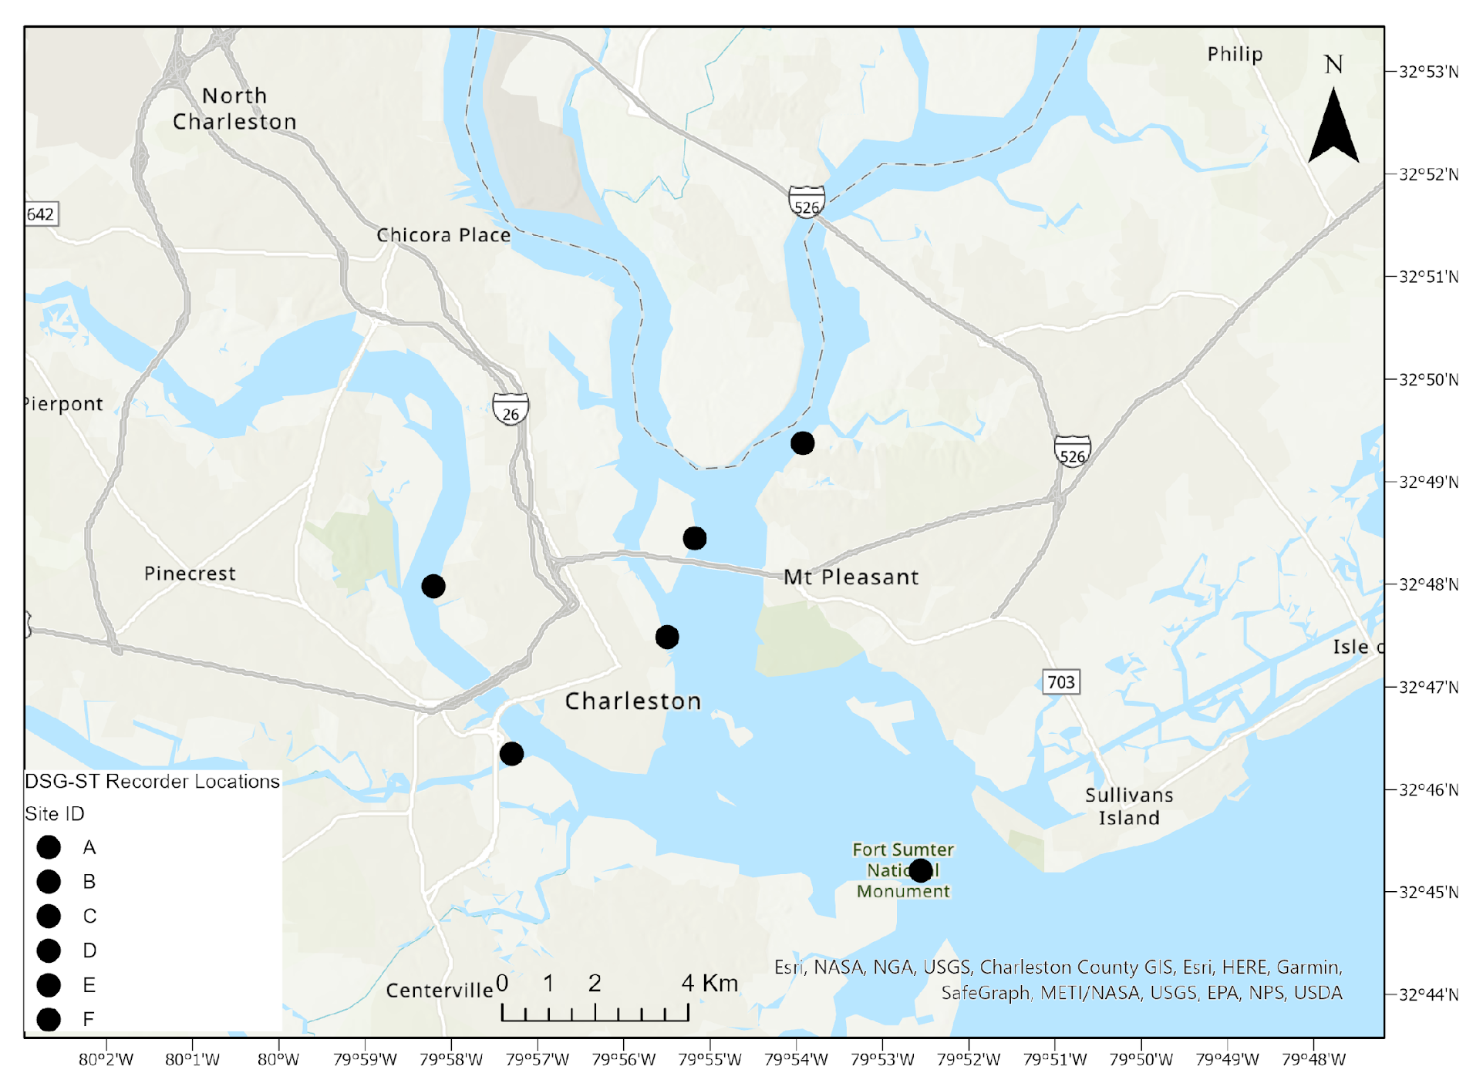
Methodology – Acoustic Surveying
Charleston Harbor
32˚40’N, 79˚55’W
DSG-ST passive acoustic recorders
2 mins every 20 mins
Sampling rate of 96 kHz
Water temperature and water level loggers
Dec 2017 to May 2019
Wando River
Cooper River
A
B
F
Ashley River
C
E
Wando River
Drum Island
SC Aquarium
Ft Sumter
Ashley River
Citadel
D
Notes:
Placement of recording stations within Charleston Harbor was determined based on core use areas of the Charleston Estuarine System Stock determined by spatial analyses on historical photo-ID surveys and due to their locations within the harbor with stations A, B, C, and D all within the shipping channel while stations E and F are not and are more representative of recreational boat traffic. These recorders are deployed for 3 months at a time then retrieved and acoustic files are manually analyzed to identify fish and dolphin vocalizations

Slide 4
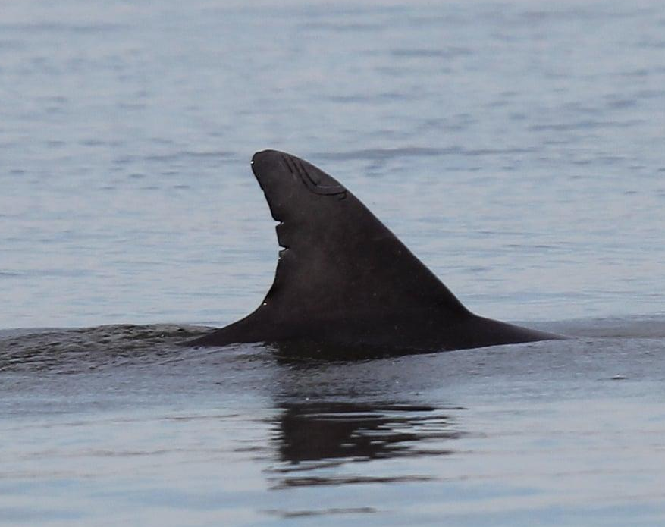
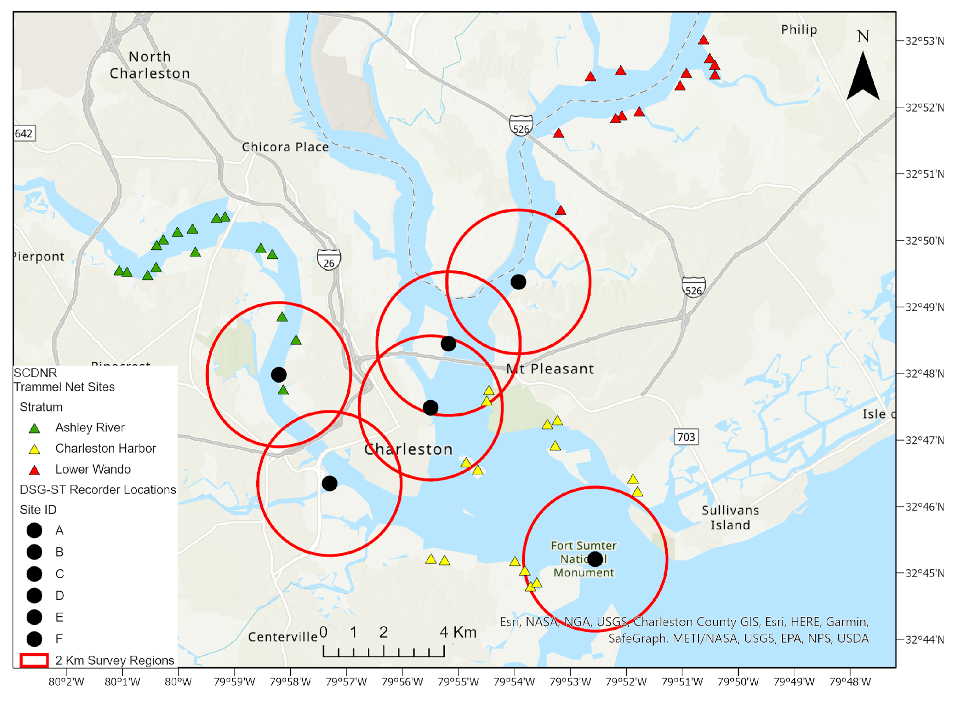
Methodology – Visual Surveying
Bimonthly
Boat-based photo-ID surveys
50 min transects at each site
Dec 2017 to May 2019
Not incorporating photo-ID catalog for this study
A
B
F
C
E
Wando
Drum Island
Aquarium
Mouth
Ashley Lower
Ashley Upper
D
NMFS Permit #24033
Photographer: C. Tribble
Notes:
Conducting these bimonthly surveys in addition to acoustic monitoring we can understand how abundance patterns over space and time may relate to vocalizations
Small vessel-based photo-ID surveys in Charleston Harbor began in June 2017 and were conducted bimonthly within a designated 2 km radius around each recording station. Once dolphin(s) were observed, sighting data collected included GPS location, start and end times of sighting, group size estimates for dolphins, calves, and neonates (i.e., minimum, maximum, and best estimate), weather conditions, water depth (m), and water quality measurements using a YSI Handheld Multiparameter Instrument. Water quality measures included water temperature, salinity, dissolved oxygen, and turbidity. These vessel-based surveys were conducted under General Authorization for Scientific Research Letter of Confirmation No. 18859 issued by NMFS to Dr. Patricia Fair. Best estimates of group size across sightings for total dolphins and total calves will be assessed temporally (i.e. by season, year, and entire study). Photographs were taken of the dorsal fin of each group member to later use photo-ID methods (Speakman et al., 2010; Balmer et al., 2012; Balmer et al., 2018) to identify individual dolphins.

Slide 5



Sampling Design
start and end times of sightings were matched to times of acoustic surveying (every 20 mins)
To understand spatial and temporal patterns
Sighting data
Acoustic data
Additional factors
GPS coordinates of sightings
Start/end time
Total dolphins (adults & calves) present
Total calves present
Total echolocation bouts
Total whistles
Total burst pulses
Total vocalizations
Noise Ratio
Fish calling scores:
(0 – no calls, 1 – one, 2 – multiple, 3 – chorusing)
Site
Season
y ~ x
Log+1(total) ~ total dolphins + site + season + fish calling score sums + noise-ratio
Notes:
Gaussian GLM with log+1 transformation of total vocalizations best model fit
Model chosen based on AIC criterion
Exploratory analysis on how factors influence vocalizations
Relating dolphin abundance to vocalizations
Montie wants me to see if there’s an effect instead of predicting dolphin abundance
Exploratory analysis – how does abundance and other factors explain vocalizations
Sighting sp. data includes - gps lat and long of boat when the dolphins were sighted, date, site, start and end times, total number of dolphins present, total number of calves present, and distance in meters of the sighting in relation to the site’s recorder, season
Acoustic sp. data includes - # echolocation bouts, # whistles, # burst pulses, total # vocals, anthro noise presence (0 or 1), fish (all species) calling score (0,1,2,3)
Potential issue in data with my question: All data described here is coming from sightings of dolphins and does not include instances where they did not see any dolphins in a given site on any given day, though this did sometimes occur. Therefore, I have no zeros in my ‘total number of dolphins present’ and I am working on adding in these data and matching to acoustics on the hour for when they didn’t see a dolphin the entire time surveying a particular site.
Initially thought a mixed effects model would be best to understand possible random effects of site since we do see spatial variation in both vocalizations and sightings. However my data is highly zero-inflated so I am trying negative binomial glm and mixed effects models.
function:
y ~ x
total dolphins ~ total vocalizations + site (factor) + season (factor) + distance from recorder + total calves + fish calling (ordered factor)

Slide 6
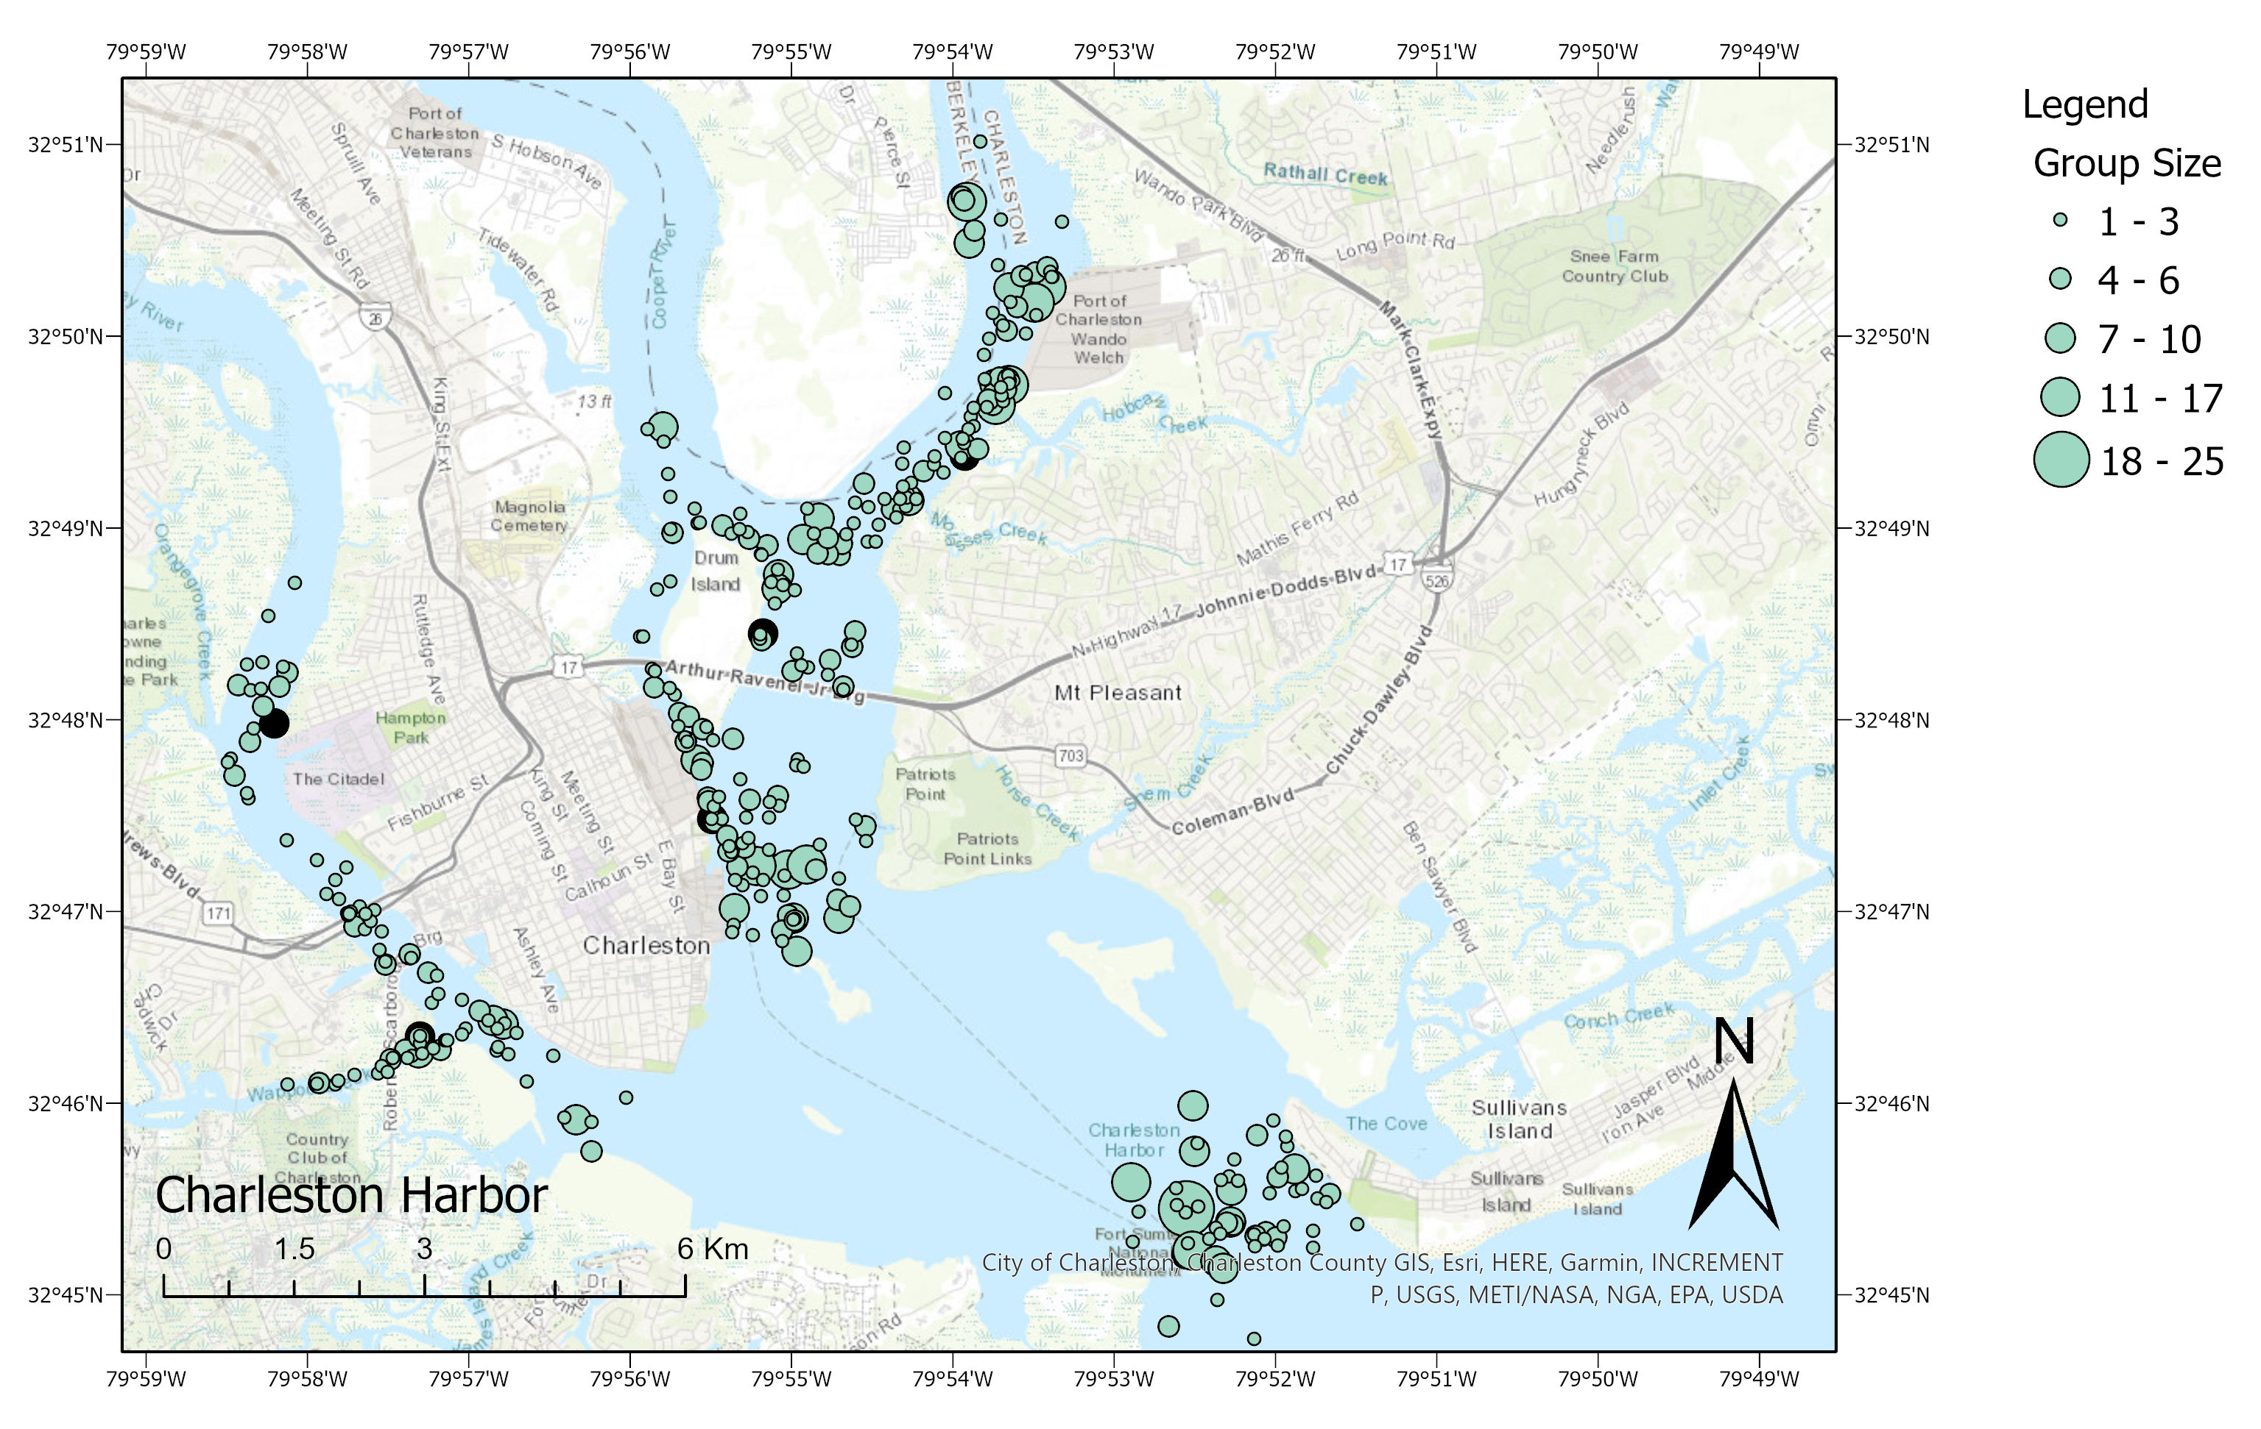
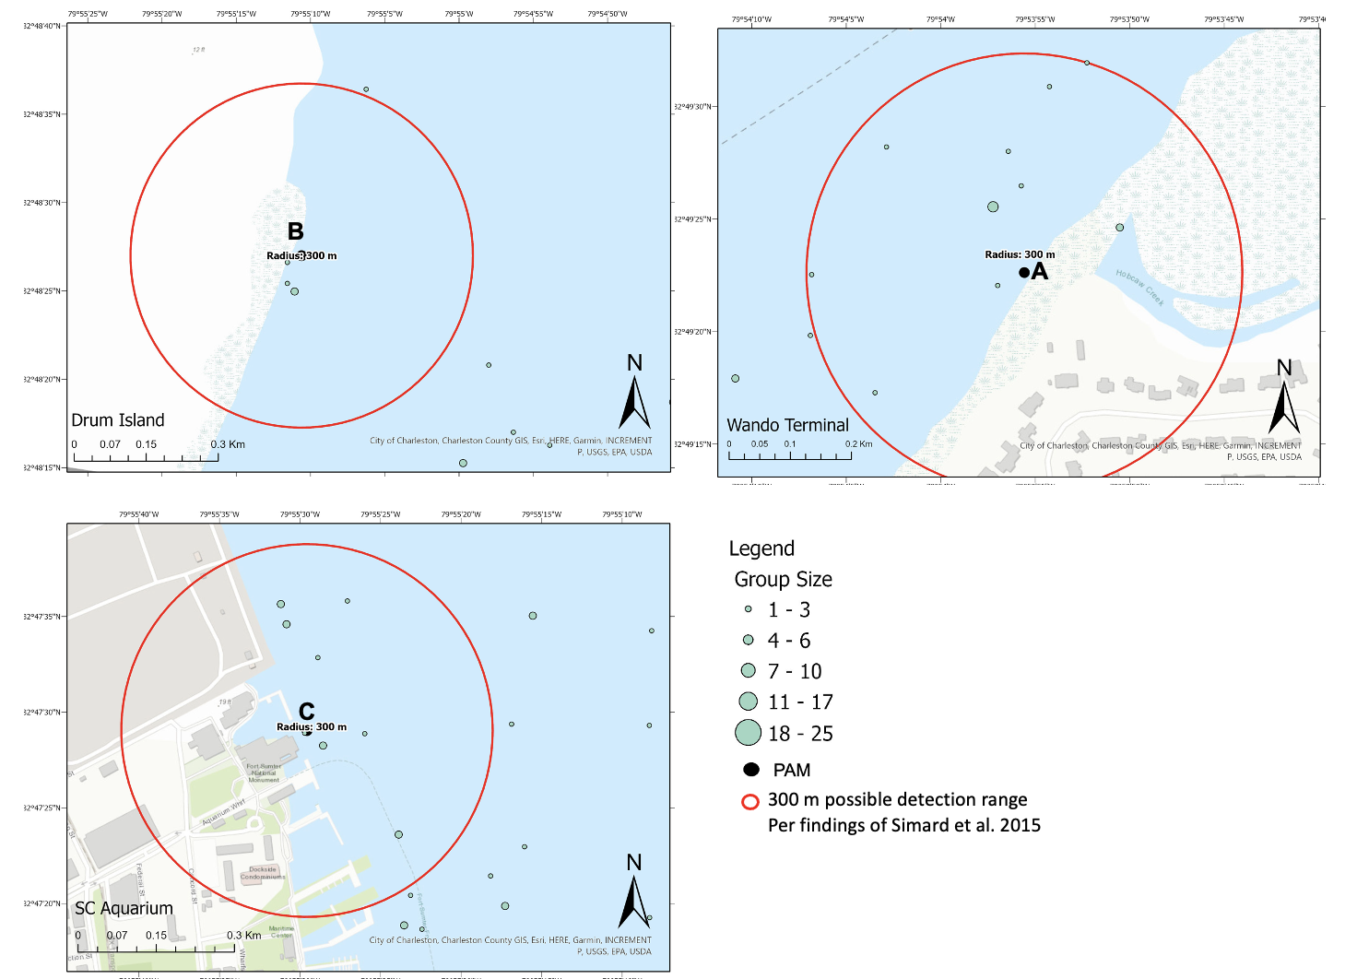

Slide 7
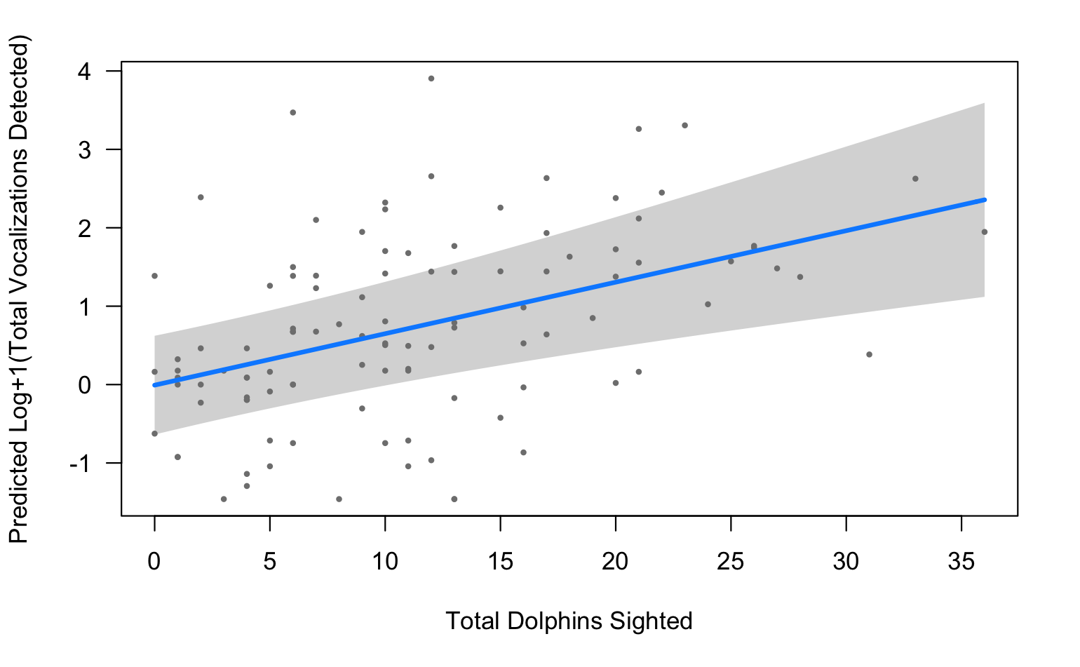
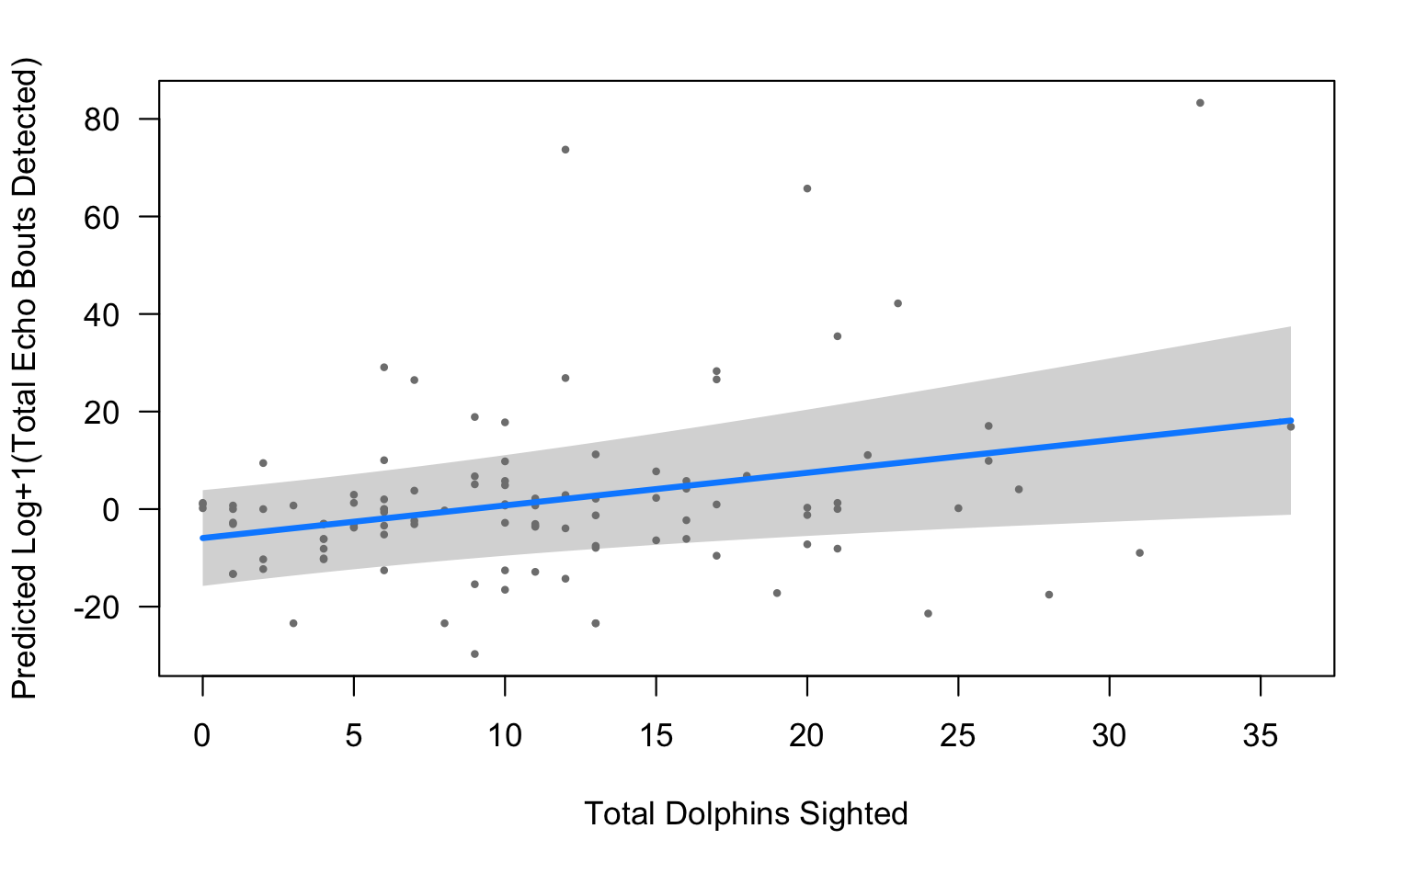
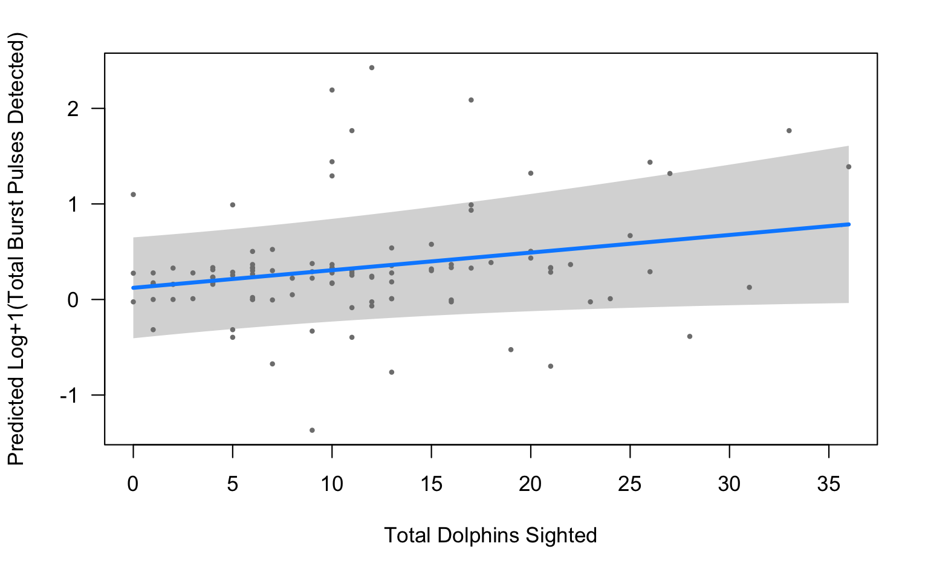
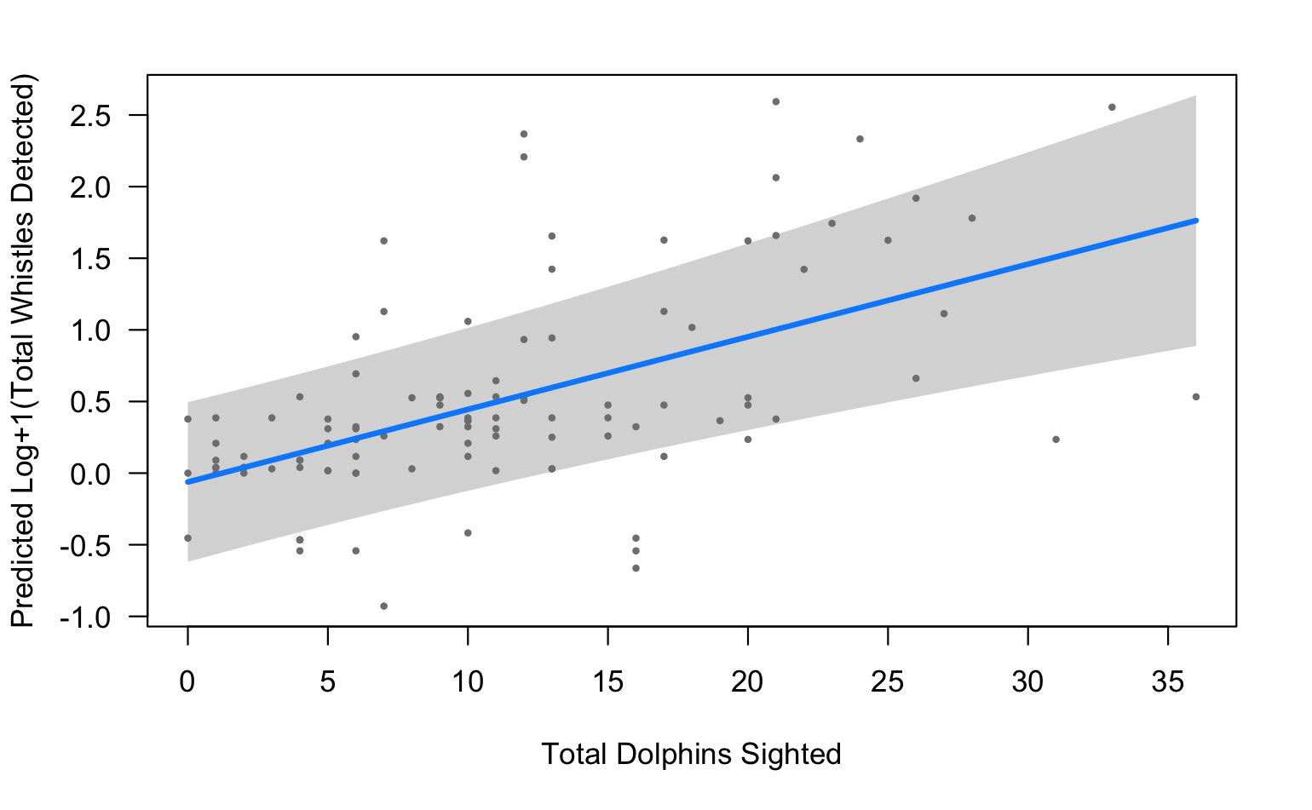
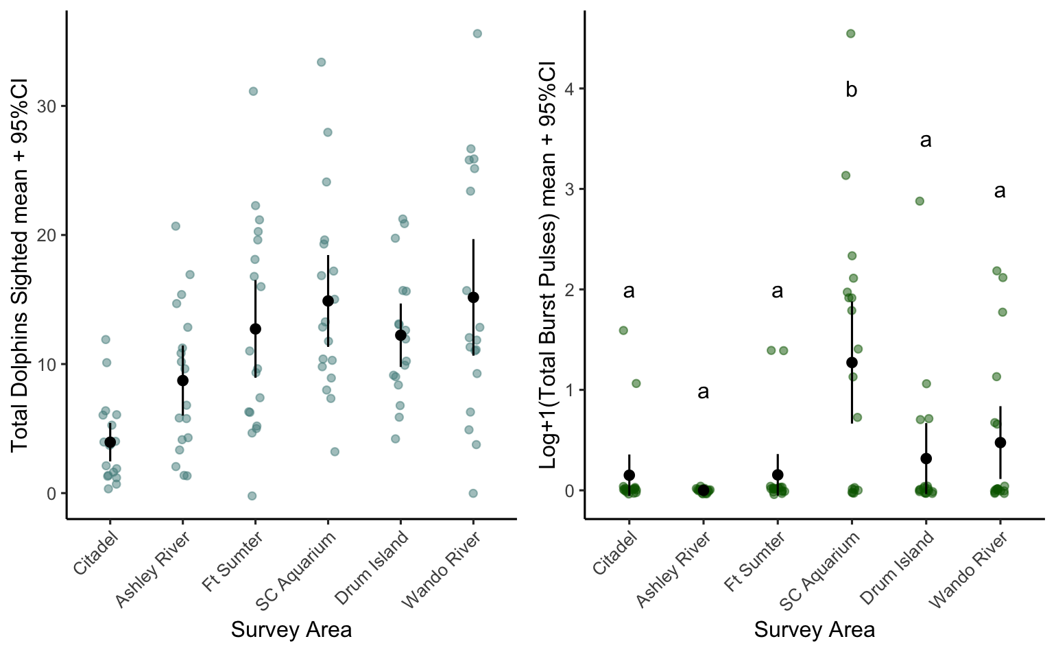
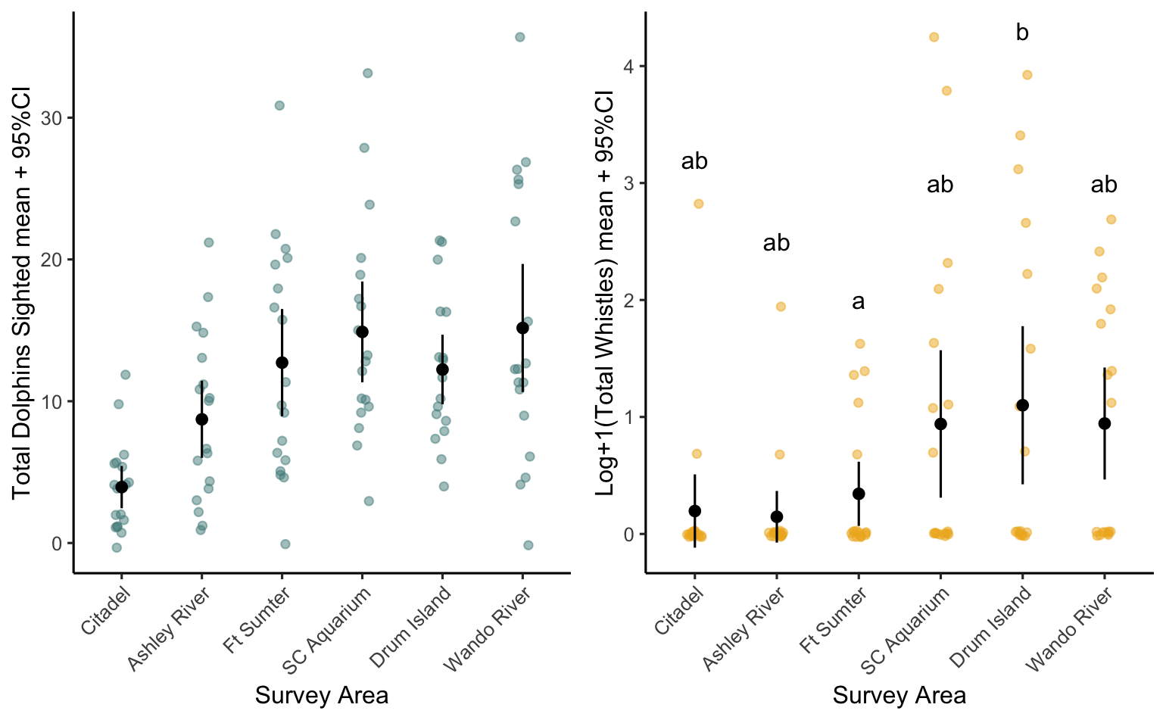
Total vocalizations
Echolocation Bouts
Burst Pulses
Whistles
Notes:
Placement of recording stations within Charleston Harbor was determined based on core use areas of the Charleston Estuarine System Stock determined by spatial analyses on historical photo-ID surveys and due to their locations within the harbor with stations A, B, C, and D all within the shipping channel while stations E and F are not and are more representative of recreational boat traffic. These recorders are deployed for 3 months at a time then retrieved and acoustic files are manually analyzed to identify fish and dolphin vocalizations

Slide 8
 | Dolphin Sighting Abundance Models
 | Generalized Linear Model | Variables Tested
 | Response Variable | Total Dolphin Vocalizations
 | Explanatory Variable | Total Dolphins Sighted
 | Factors | Season
 |  | Station Fish Calling Sums
 | Generalized Linear Model
 | Response Variable | Echolocation
 | Explanatory Variable | Total Dolphins Sighted
 | Factors | Season
 |  | Station Fish Calling Sums
 | Generalized Linear Model
 | Response Variable | Burst Pulses
 | Explanatory Variable | Total Dolphins Sighted
 | Factors | Season
 |  | Station Fish Calling Sums
 | Generalized Linear Model
 | Response Variable | Whistles
 | Explanatory Variable | Total Dolphins Sighted
 | Factors | Season
 |  | Station Fish Calling Sums
 | Dolphin Vocalization & Sighting Abundance Models
 | Total Vocalizations Model | Likelihood ratio chi-square | p
 | Station | 31.134 | <.001
 | Season | 22.45 | <.001
 | Total Dolphins Sighted | 16.341 | <.001
 | Silver Perch | 5.2708 | 0.0217
 | Red Drum | 0.931 | 0.3346
 | Echolocation Model
 | Station | 25.196 | <.001
 | Season | 21.342 | <.001
 | Total Dolphins Sighted | 8.213 | 0.004
 | Red Drum | 3.997 | 0.045
 | Silver Perch | 1.368 | 0.242
 | Burst Pulses Model
 | Station*Season | 30.439 | 0.010
 | Station | 29.995 | <.001
 | Season | 13.278 | 0.004
 | Total Dolphins Sighted | 4.4298 | 0.035
 | Red Drum | 2.059 | 0.151
 | Spotted Seatrout | 0.509 | 0.476
 | Whistles Model
 | Station*Season | 45.254 | <.001
 | Season | 35.951 | <.001
 | Total Dolphins Sighted | 26.134 | <.001
 | Station | 12.876 | 0.0246
Notes:
model selection was based on a forward stepwise selection process and relied upon Akaike information criterion (AIC).

Slide 9
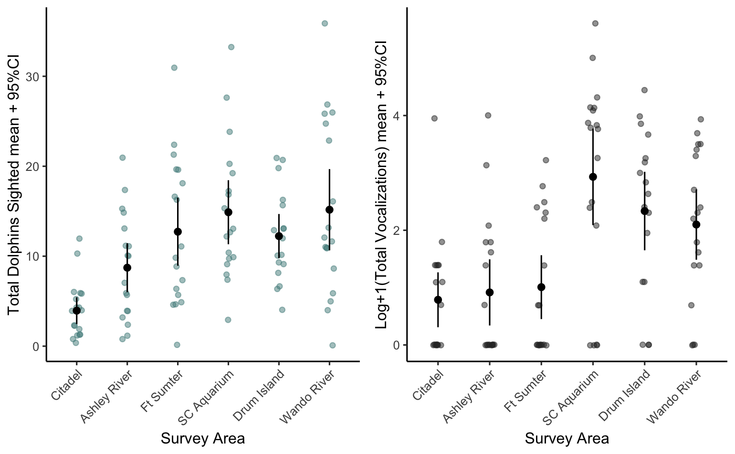
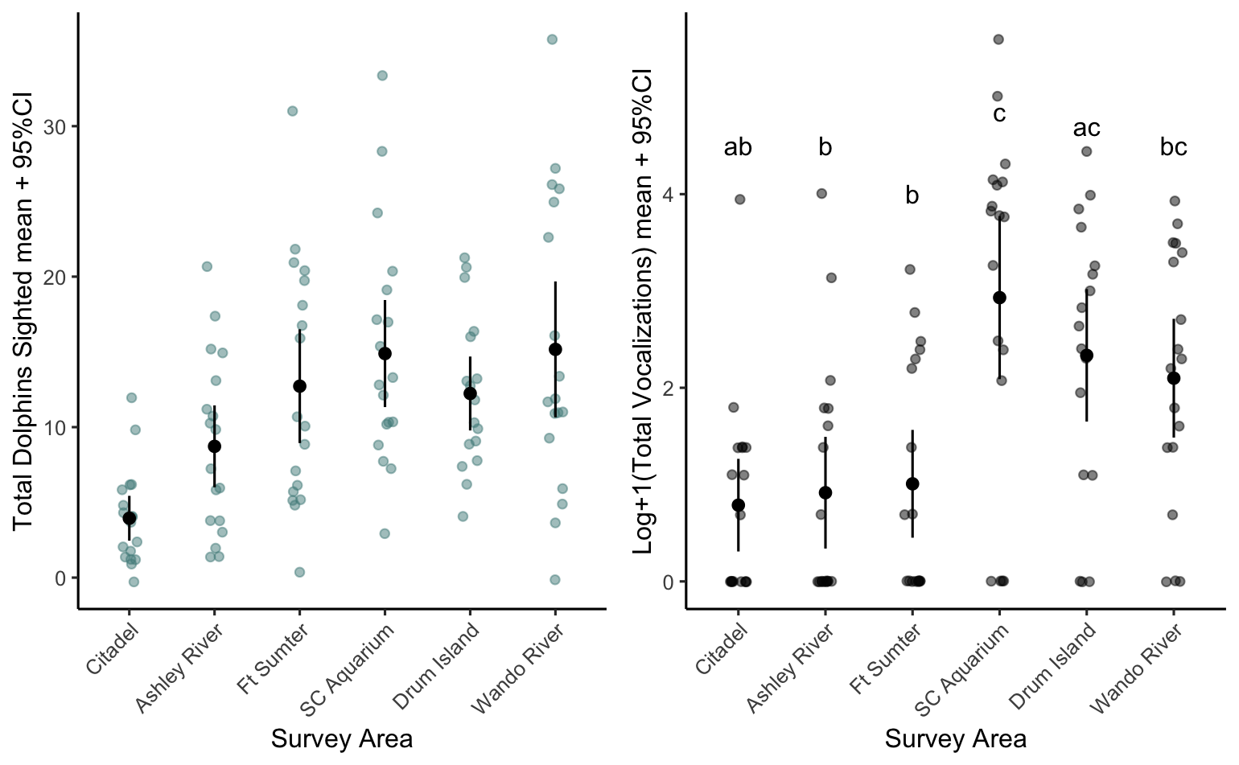
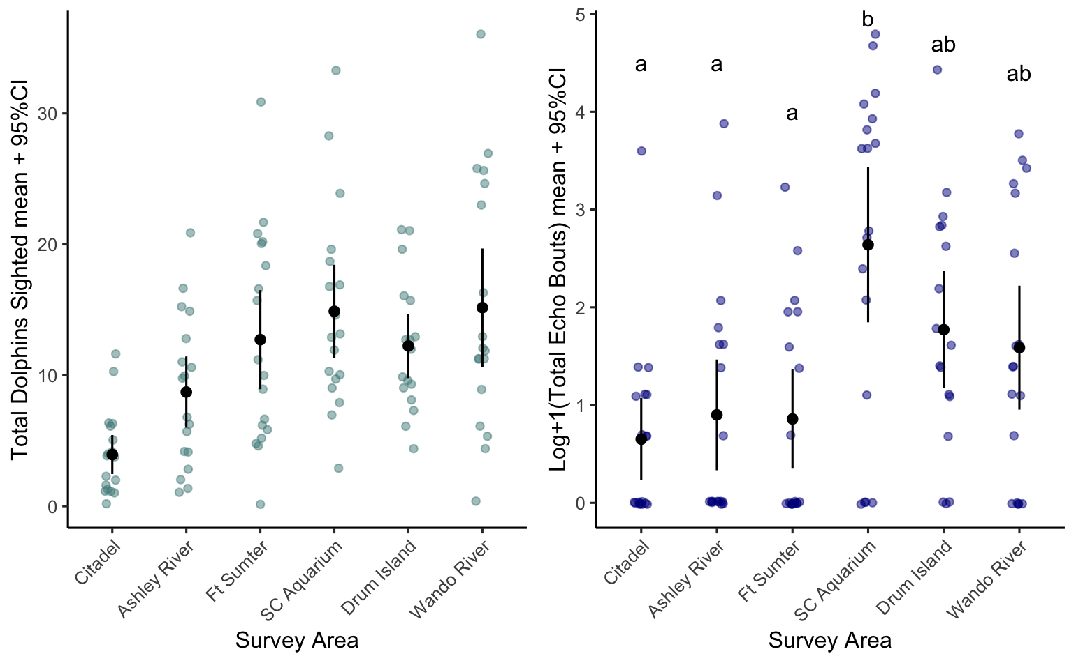
Sighting and Vocalization Patterns across Survey Areas -
Total dolphins sighted
Total vocalizations
Echolocation Bouts
*Lettering above are based on Tukey Kramer HSD post hoc tests. Different letters indicate significant differences in group means (p < .05).
Notes:
Placement of recording stations within Charleston Harbor was determined based on core use areas of the Charleston Estuarine System Stock determined by spatial analyses on historical photo-ID surveys and due to their locations within the harbor with stations A, B, C, and D all within the shipping channel while stations E and F are not and are more representative of recreational boat traffic. These recorders are deployed for 3 months at a time then retrieved and acoustic files are manually analyzed to identify fish and dolphin vocalizations

Slide 10
Sighting and Vocalization Patterns across Survey Areas -
Total dolphins sighted
Burst Pulses
Whistles
*Lettering above are based on Tukey Kramer HSD post hoc tests. Different letters indicate significant differences in group means (p < .05).
Notes:
Placement of recording stations within Charleston Harbor was determined based on core use areas of the Charleston Estuarine System Stock determined by spatial analyses on historical photo-ID surveys and due to their locations within the harbor with stations A, B, C, and D all within the shipping channel while stations E and F are not and are more representative of recreational boat traffic. These recorders are deployed for 3 months at a time then retrieved and acoustic files are manually analyzed to identify fish and dolphin vocalizations

Slide 11
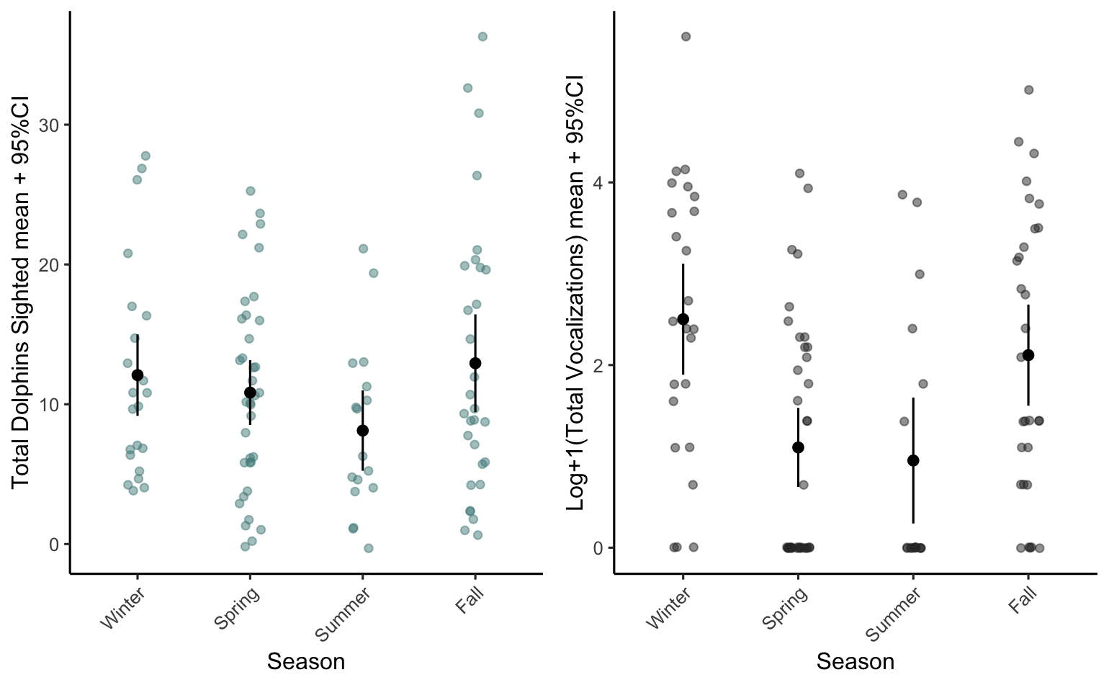
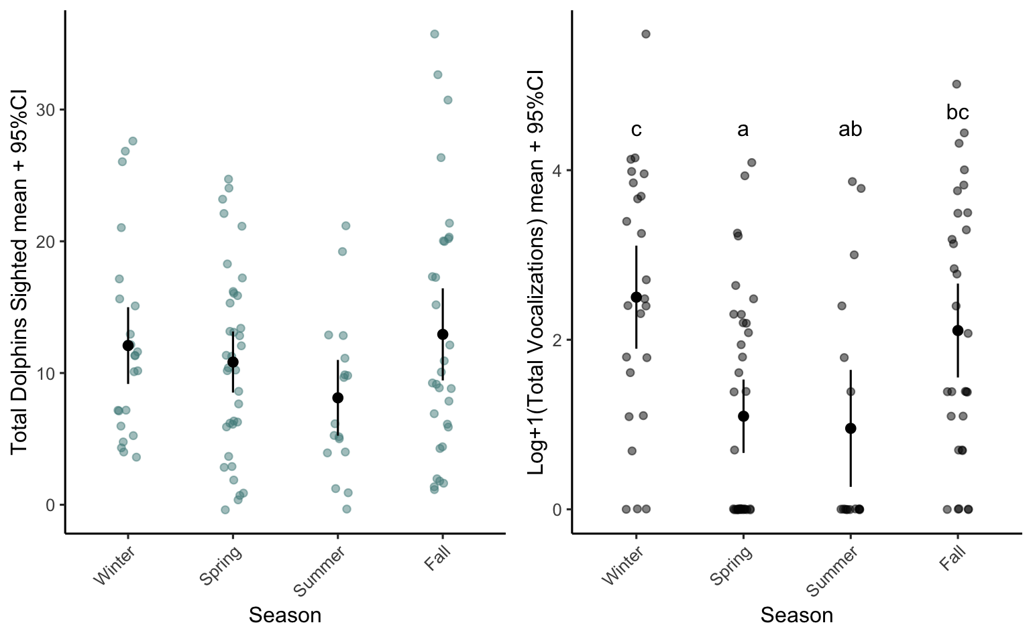
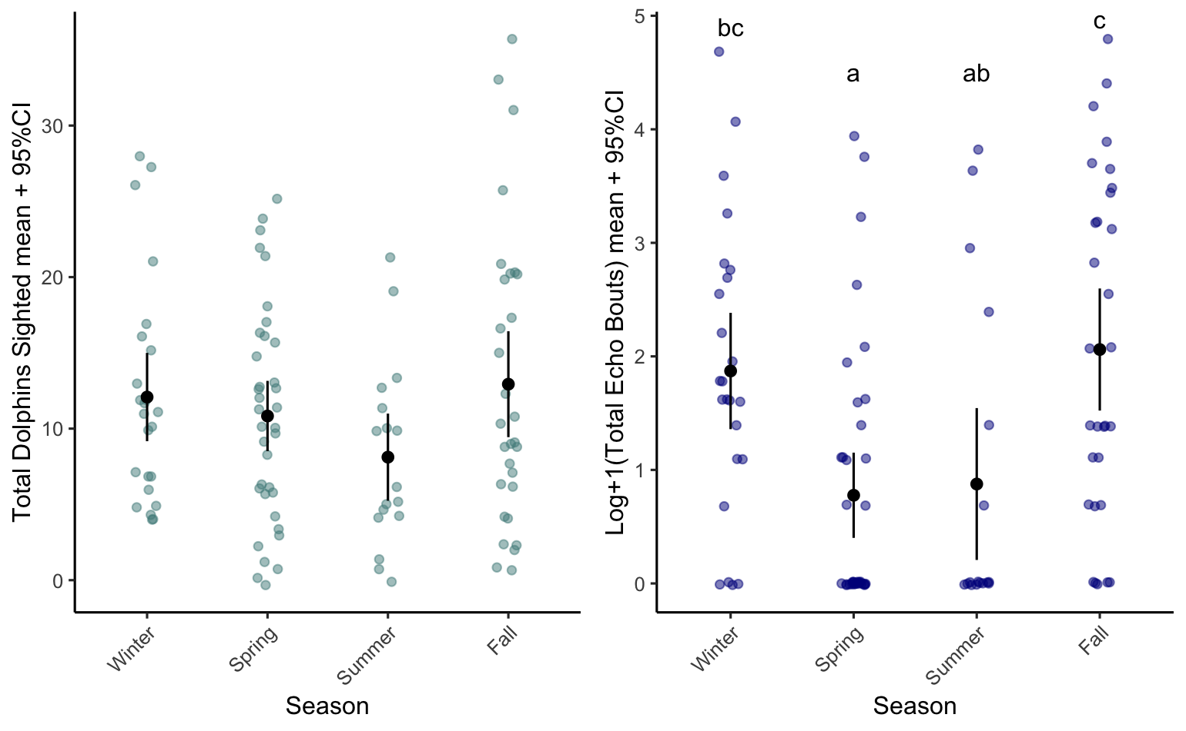
Sighting and Vocalization Patterns across Seasons-
Total dolphins sighted
Total vocalizations
Echolocation Bouts
*Lettering above are based on Tukey Kramer HSD post hoc tests. Different letters indicate significant differences in group means (p < .05).
Notes:
Placement of recording stations within Charleston Harbor was determined based on core use areas of the Charleston Estuarine System Stock determined by spatial analyses on historical photo-ID surveys and due to their locations within the harbor with stations A, B, C, and D all within the shipping channel while stations E and F are not and are more representative of recreational boat traffic. These recorders are deployed for 3 months at a time then retrieved and acoustic files are manually analyzed to identify fish and dolphin vocalizations

Slide 12
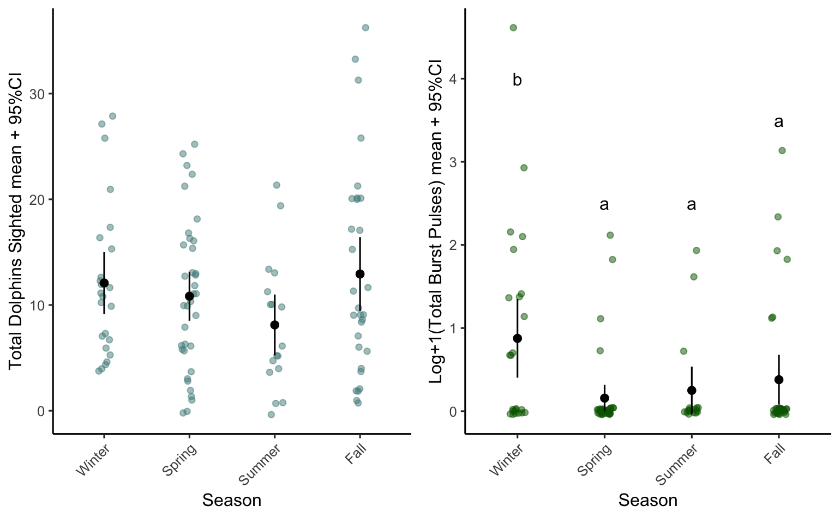
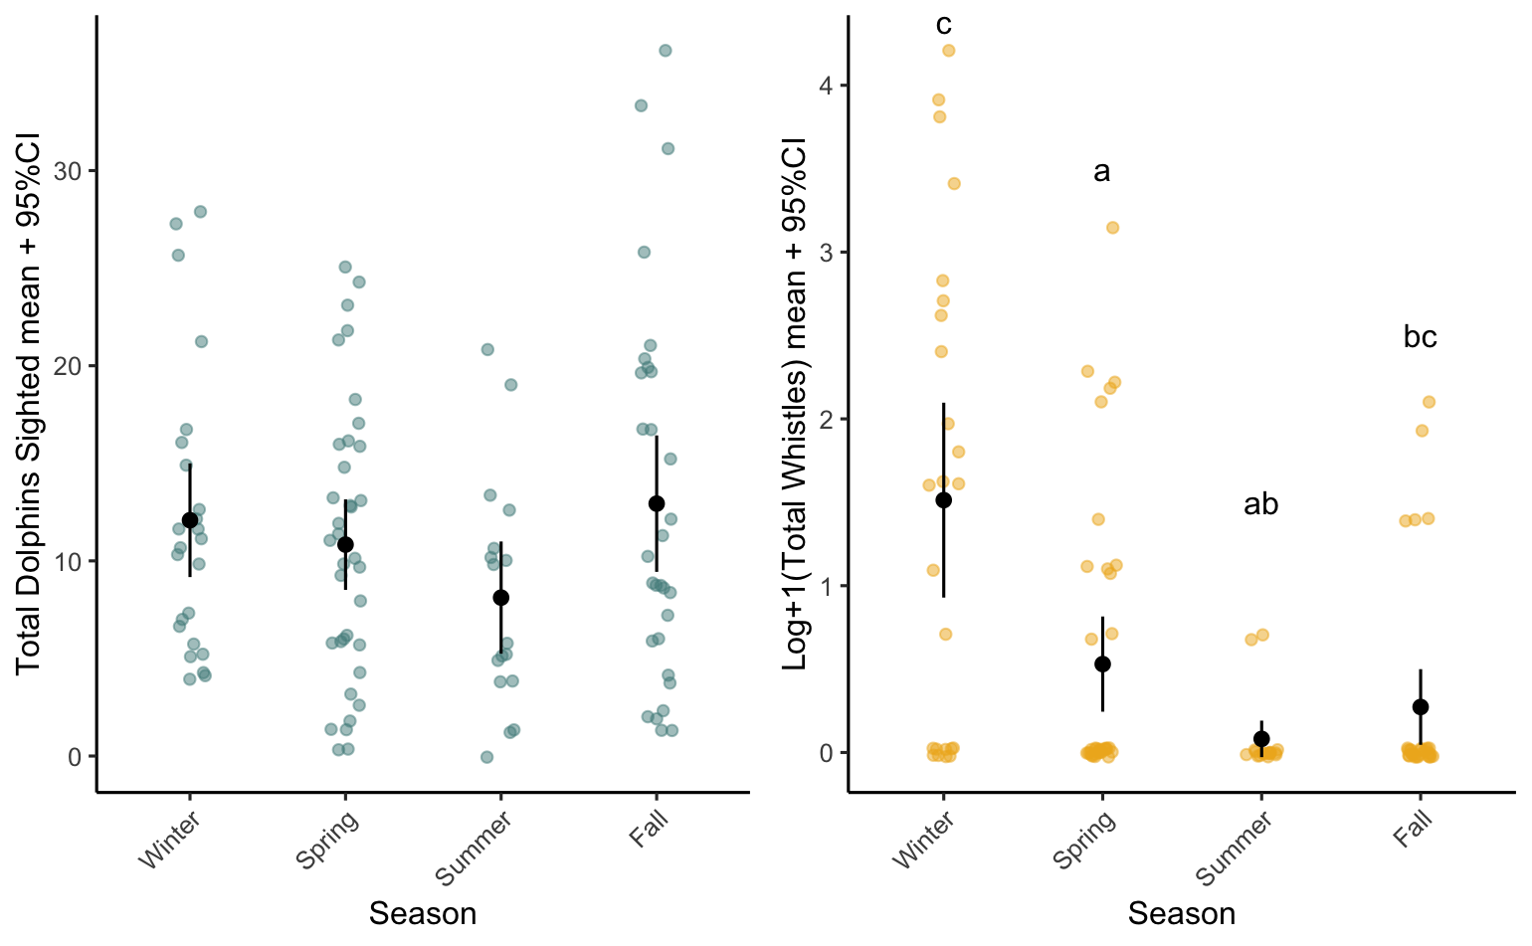
Sighting and Vocalization Patterns across Seasons-
Total dolphins sighted
Burst Pulses
Whistles
*Lettering above are based on Tukey Kramer HSD post hoc tests. Different letters indicate significant differences in group means (p < .05).
Notes:
Placement of recording stations within Charleston Harbor was determined based on core use areas of the Charleston Estuarine System Stock determined by spatial analyses on historical photo-ID surveys and due to their locations within the harbor with stations A, B, C, and D all within the shipping channel while stations E and F are not and are more representative of recreational boat traffic. These recorders are deployed for 3 months at a time then retrieved and acoustic files are manually analyzed to identify fish and dolphin vocalizations

Slide 13
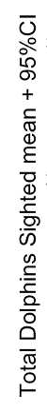
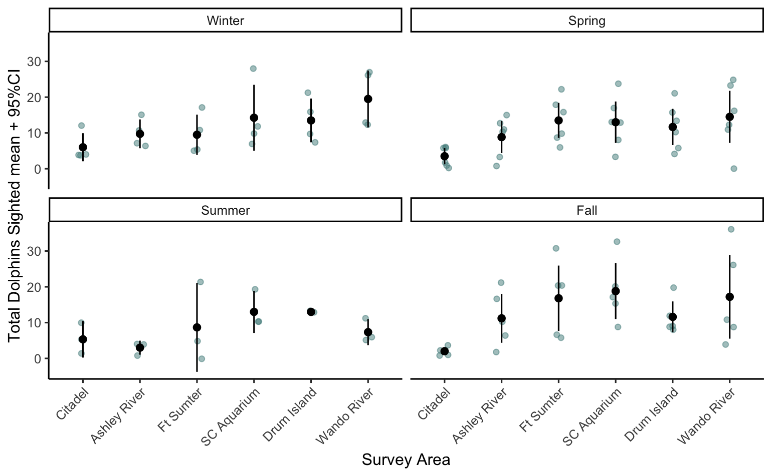
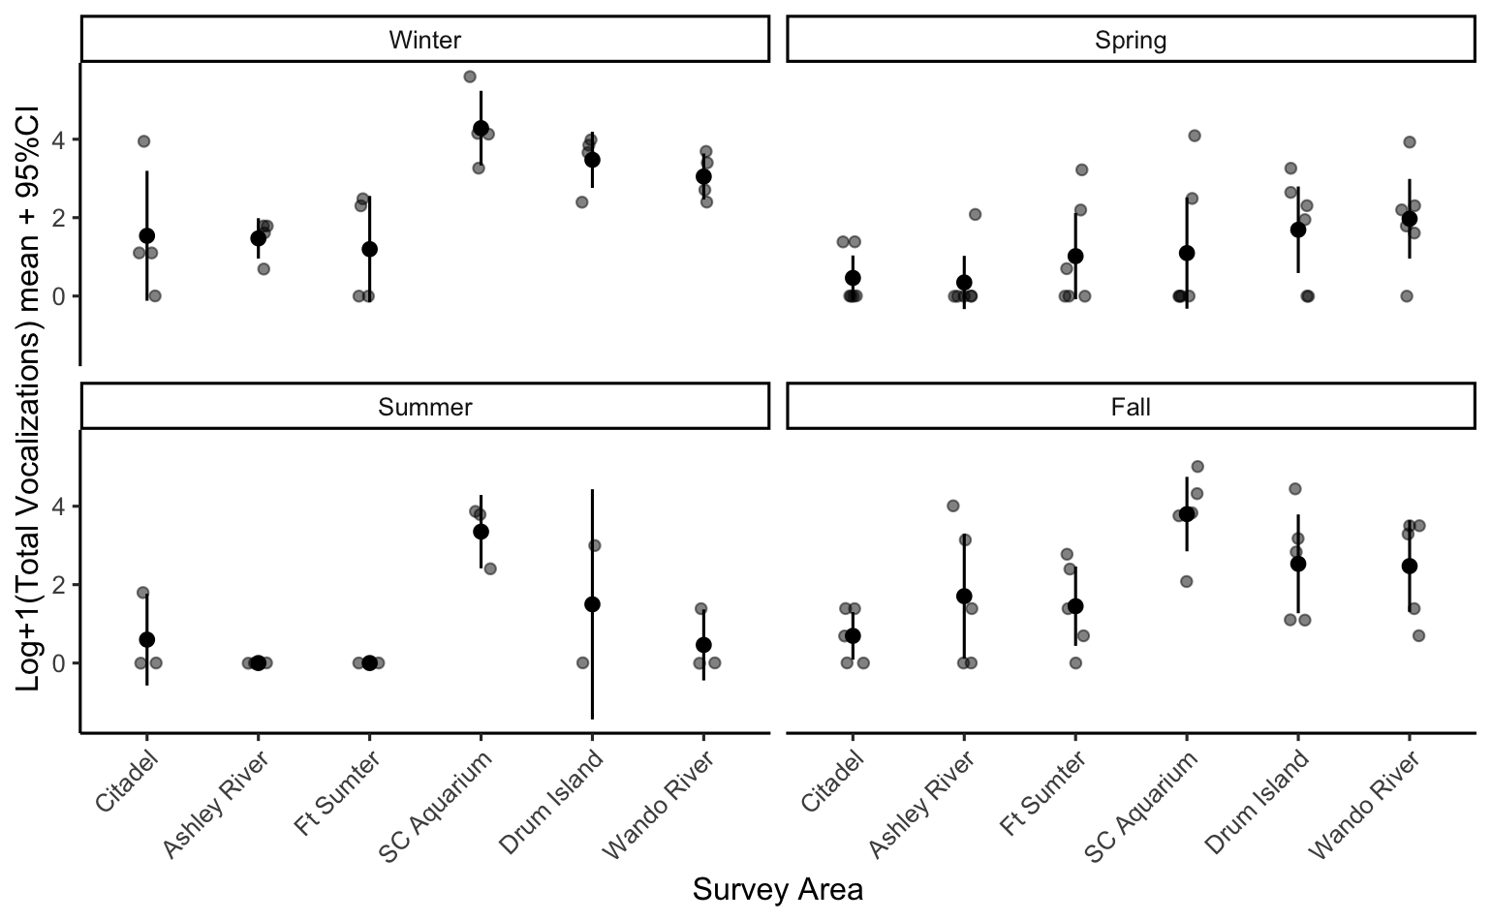
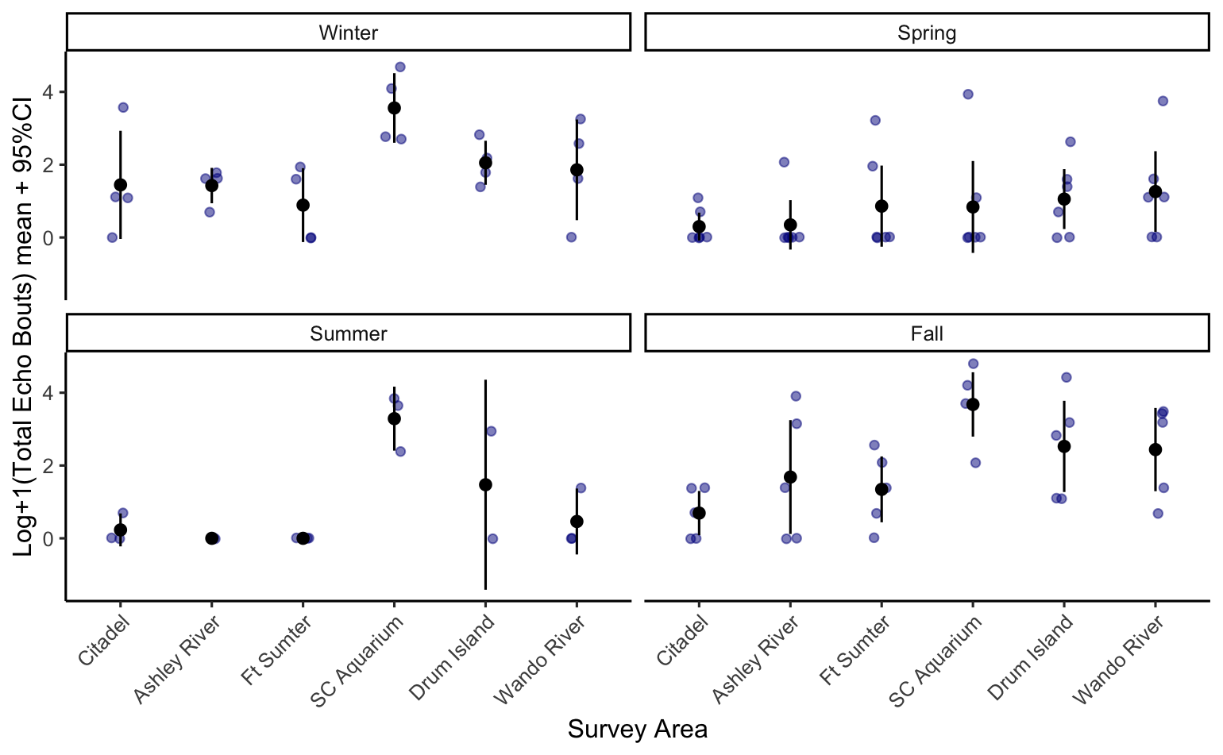
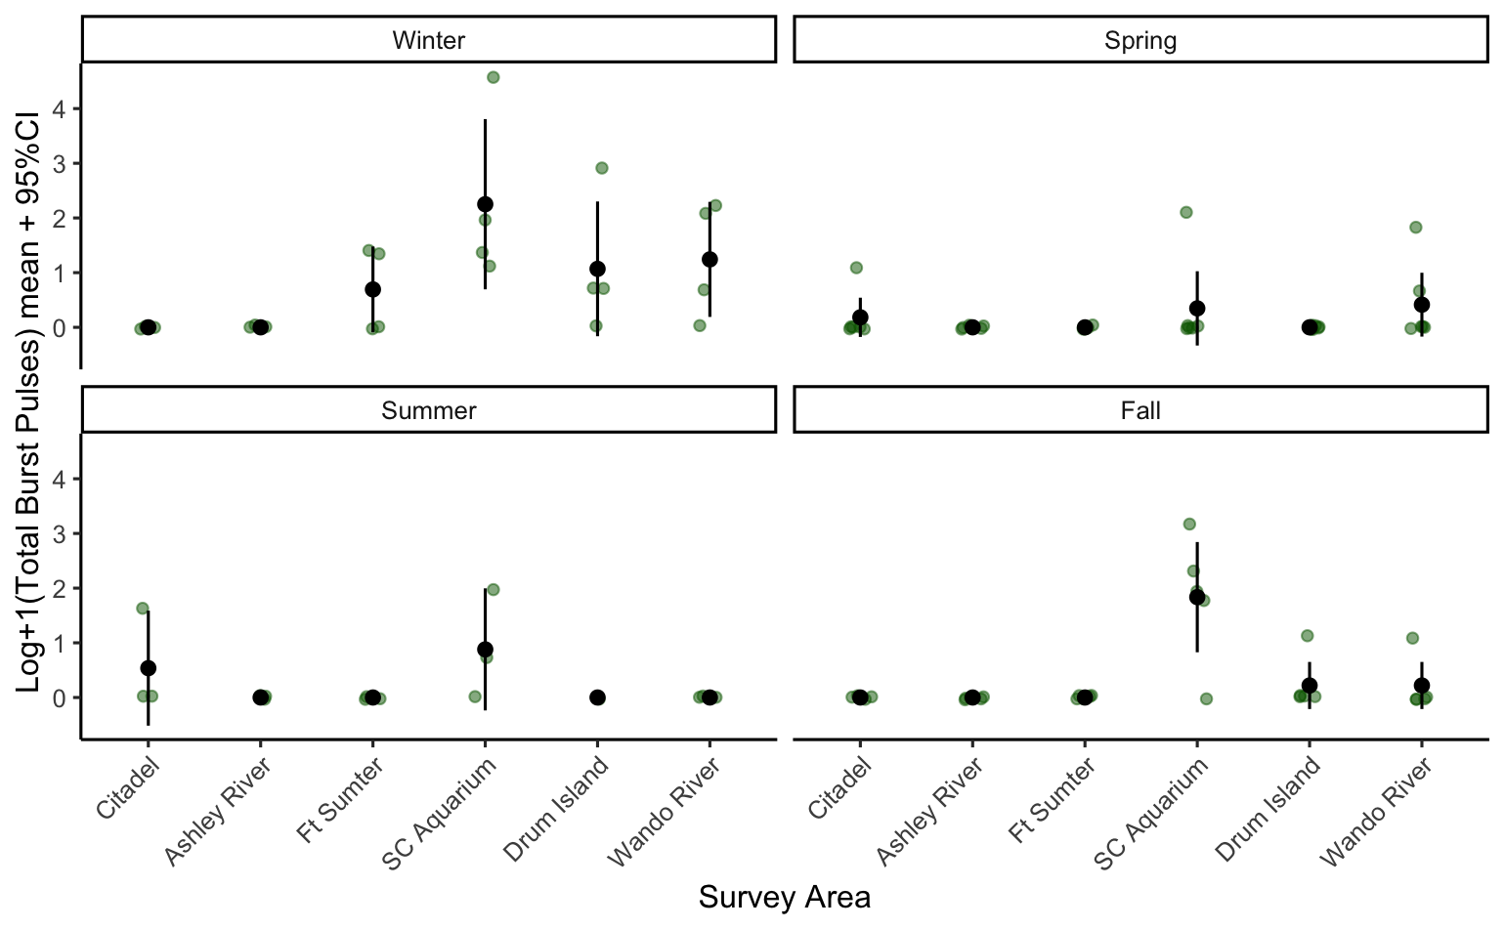
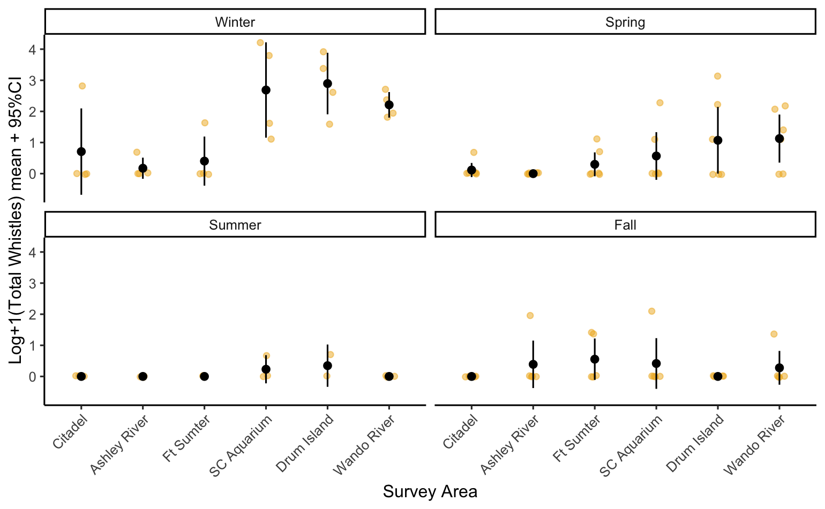
Notes:
Placement of recording stations within Charleston Harbor was determined based on core use areas of the Charleston Estuarine System Stock determined by spatial analyses on historical photo-ID surveys and due to their locations within the harbor with stations A, B, C, and D all within the shipping channel while stations E and F are not and are more representative of recreational boat traffic. These recorders are deployed for 3 months at a time then retrieved and acoustic files are manually analyzed to identify fish and dolphin vocalizations

Slide 14
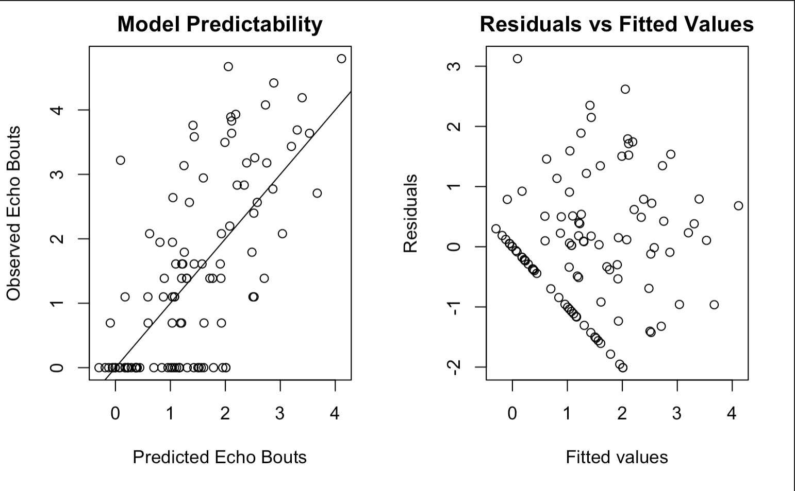
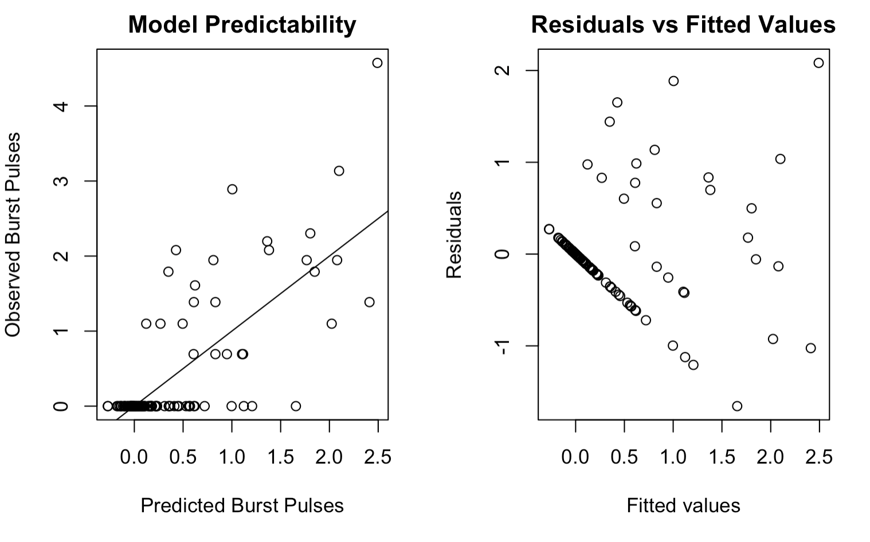
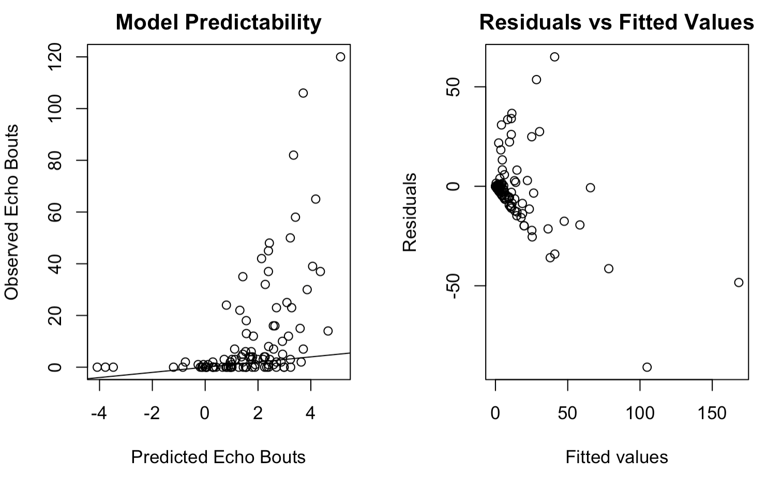
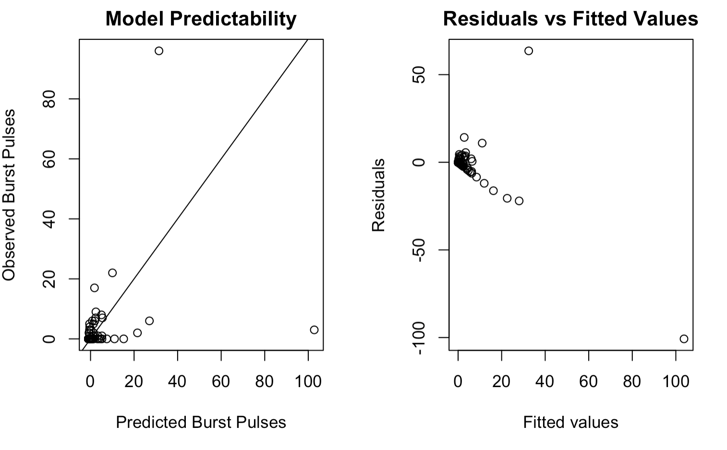
Support for Gaussian GLM with Log+1 Transformation
Gaussian GLM with Log+1 Transformation
Negative Binomial GLM with No Transformation

Slide 15
Conclusions
Significant positive relationship between dolphin vocalizations and sightings
Noise ratio and calf presence not significant
Little to no significant effect of fish calling
Strong spatial and temporal patterns
SC Aquarium is the most active region
Citadel in the upper Ashley River is least active
Spring and Summer vocalization patterns significantly different
Winter variation across sites
Unable to tease out detection range

Slide 16
Future Studies
Abundance patterns highly variable across years
More long-term data would increase resolution and may allow detection range investigation
Tying in prey abundance
Compare patterns to the May River to better understand potential impacts of noise
Notes:
looking at these patterns over multiple years may allow for detection range investigation

Slide 17
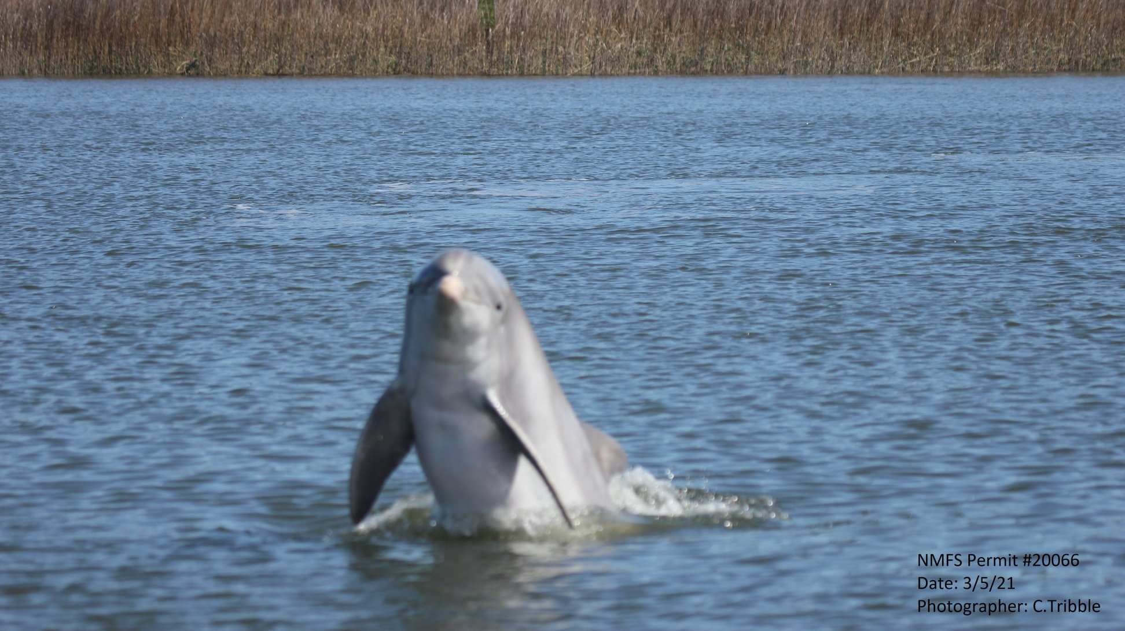
Questions?

